Slide 1

Final Project
May 12, 2021
Syracuse University
iSchool - IST 707
Zeyang Zhou
Reporter:
Notes:
My final project topic is about video games sales

Slide 2
CONTENT
Final Report
Overview
Data Preparation
Model
Result
Notes:
Frist it will be about the overview of whole project; what I have done in data preprocessing; visualizations which will be included in my final report;

Slide 3
Overview
Goal:
Three different machine learning algorithms KNN, SVM and Apriori will be used in this data mining project.
PREDICTION
ASSOCIATION RULES
Dataset:
This dataset contains a list of video games with sales greater than 100,000 copies.
Size: 2 MB
Fields:
Rank, Name , Platform , Year , Genre , Publisher , NA_Sales , EU_Sales , JP_Sales , Other_Sales , Global_Sales
Tool: R Studio, Weka
Notes:
From Kaagle, small size; not cost too much time on running. High sales games or high sales rules.

Slide 4
Dataset:

Slide 5
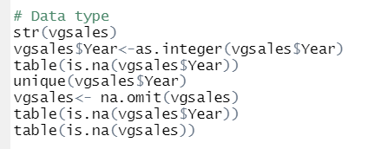
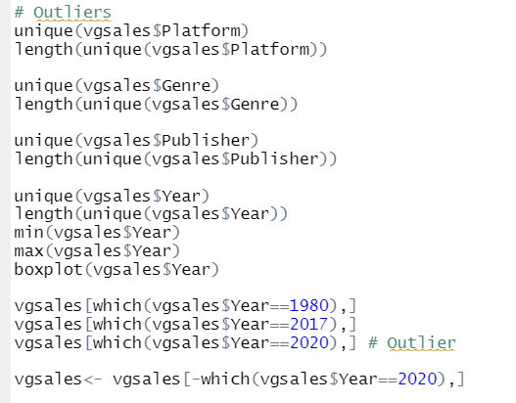
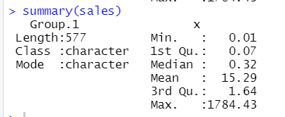
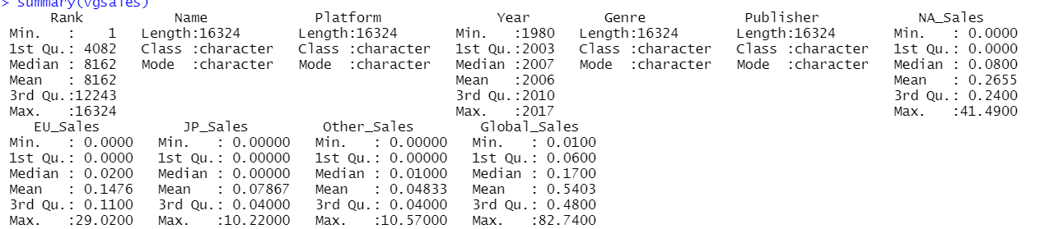
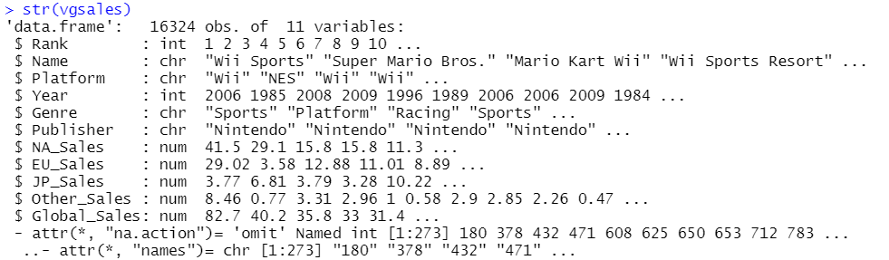
Preparation
Missing values
Data type
Outlier
Rank
Training and test sets (60%-40%)
Descriptive analysis
Notes:
1. Global sales 2. year character 3. Boxplot used to find outlier; like 2020 2017 in year; This dataset is about sales from 1980 to 2016. Rank: rerank

Slide 6
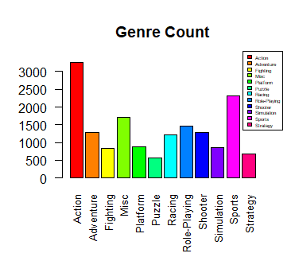
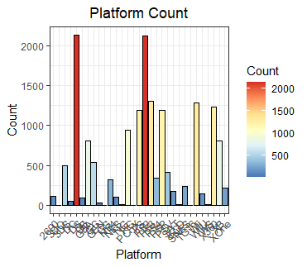
Visualization

Slide 7
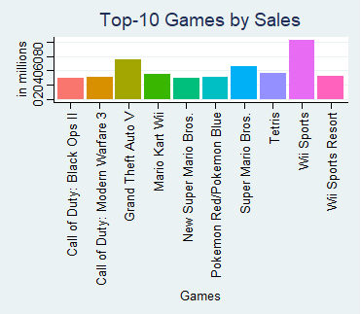
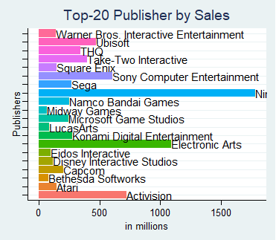

Slide 8
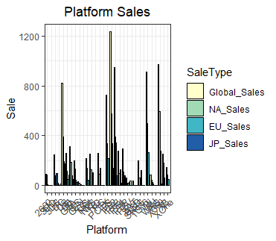
Nintendo
X360
ps3
Wii
Ds

Slide 9
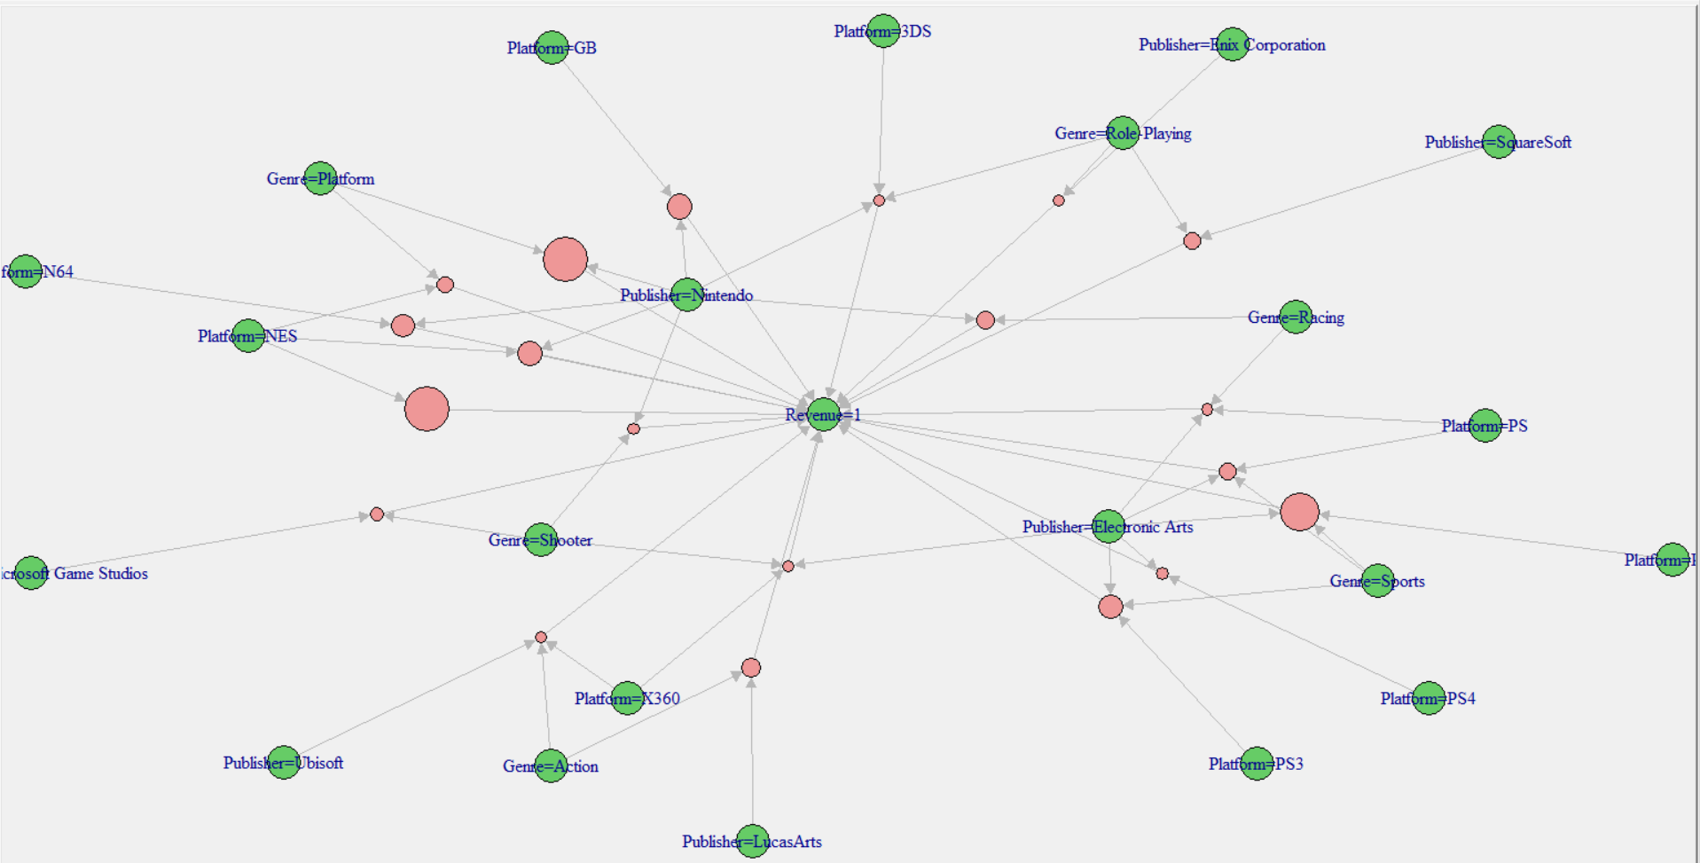
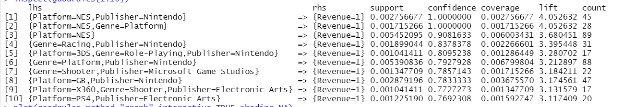
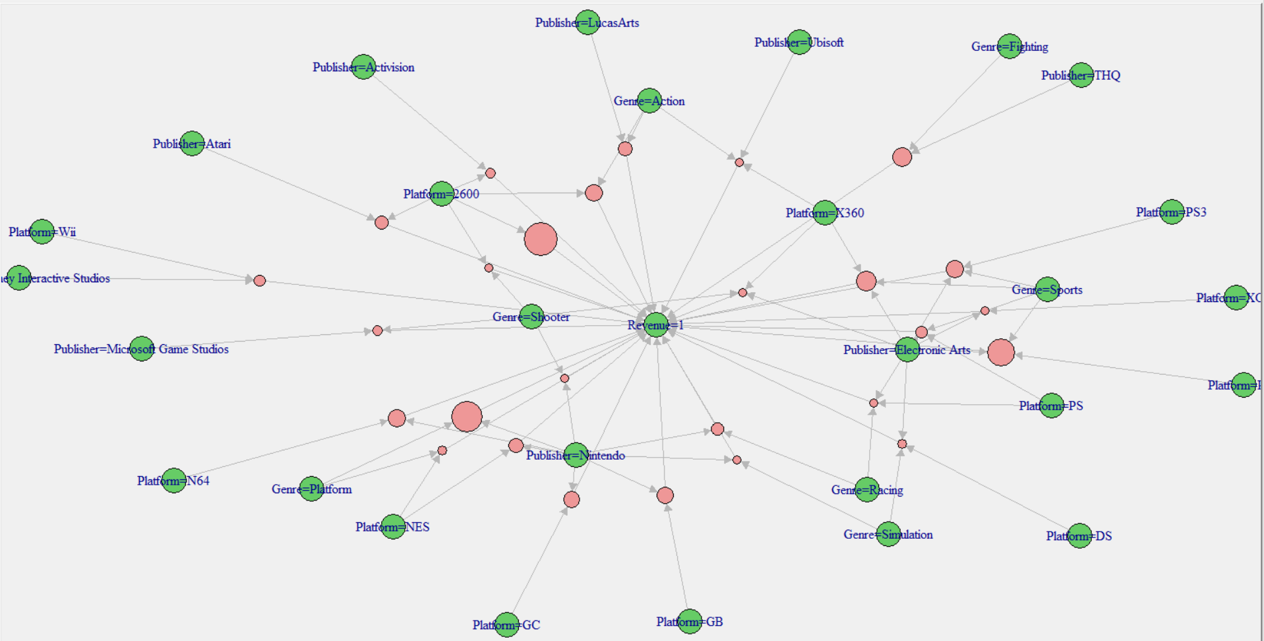
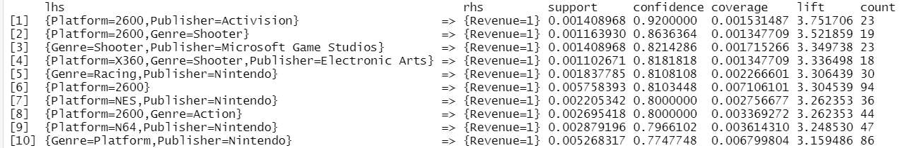
Apriori
Global Sales
NA

Slide 10
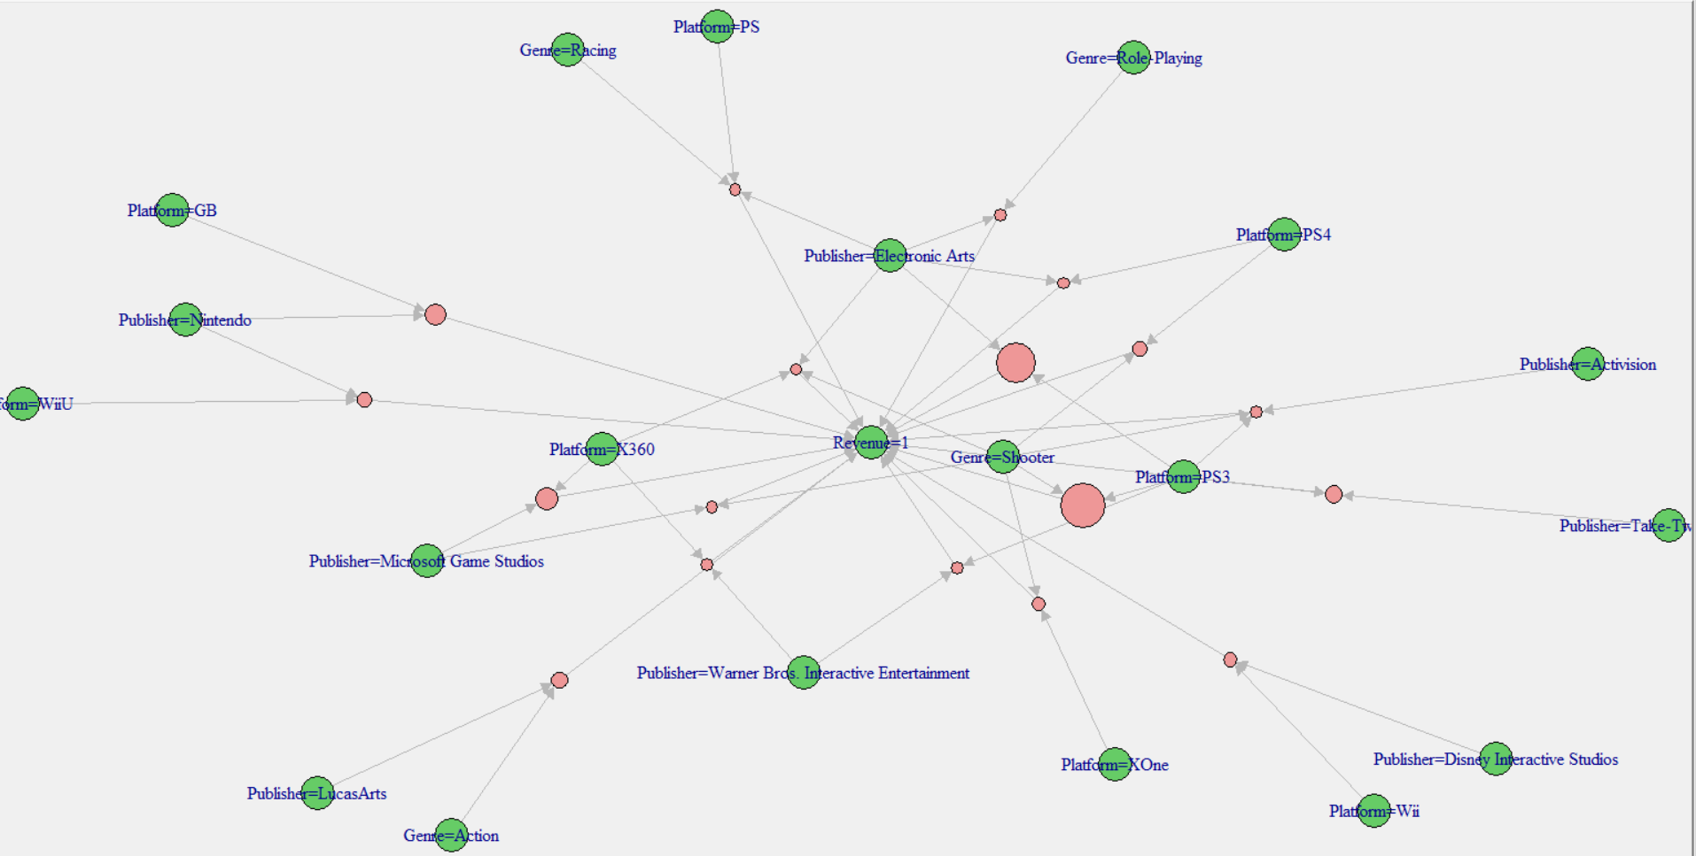
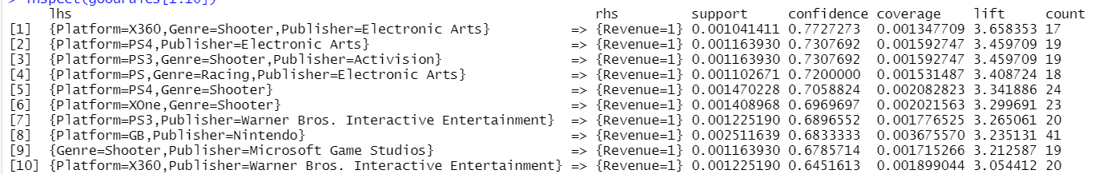
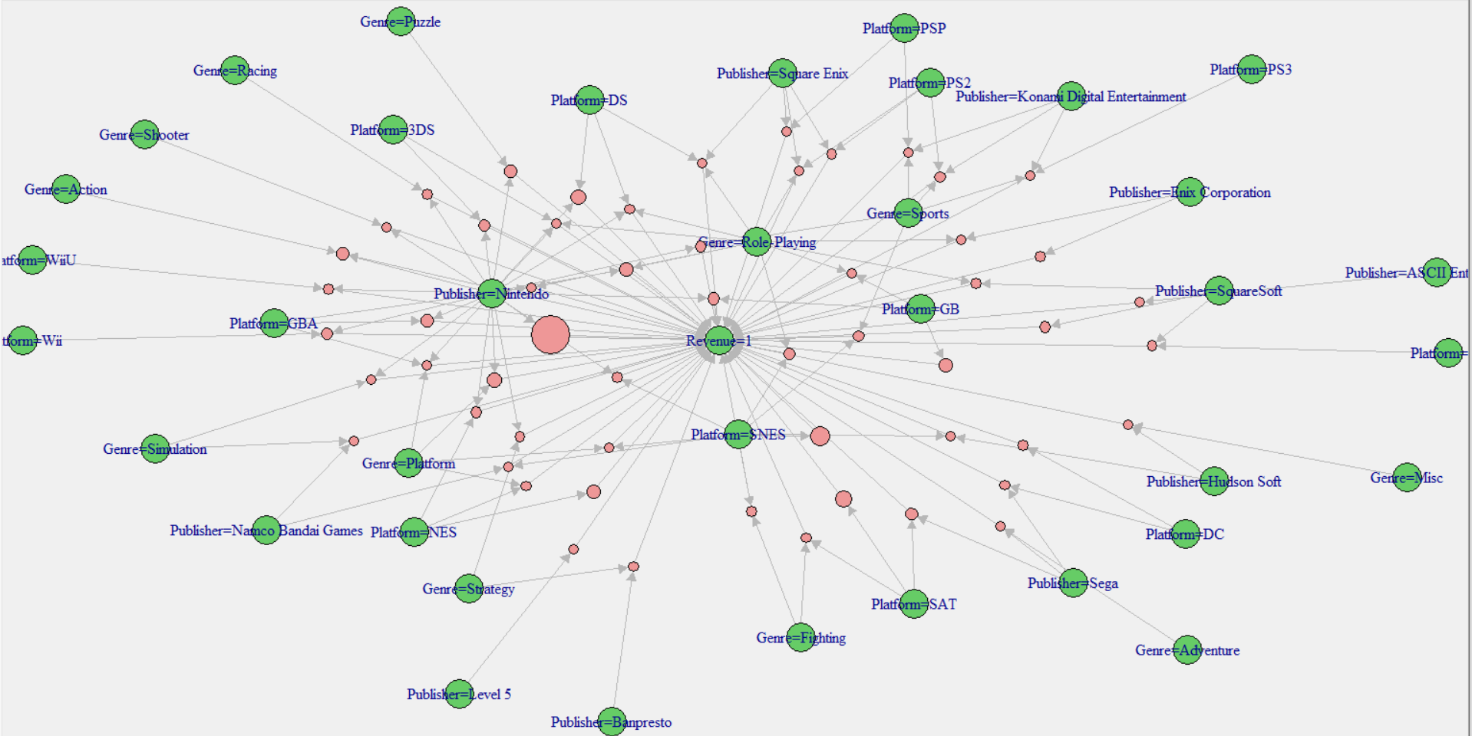
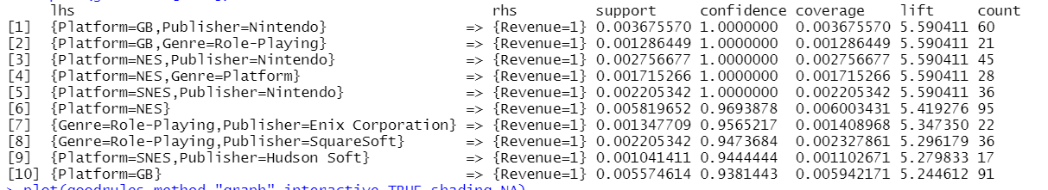
EU
JP

Slide 11
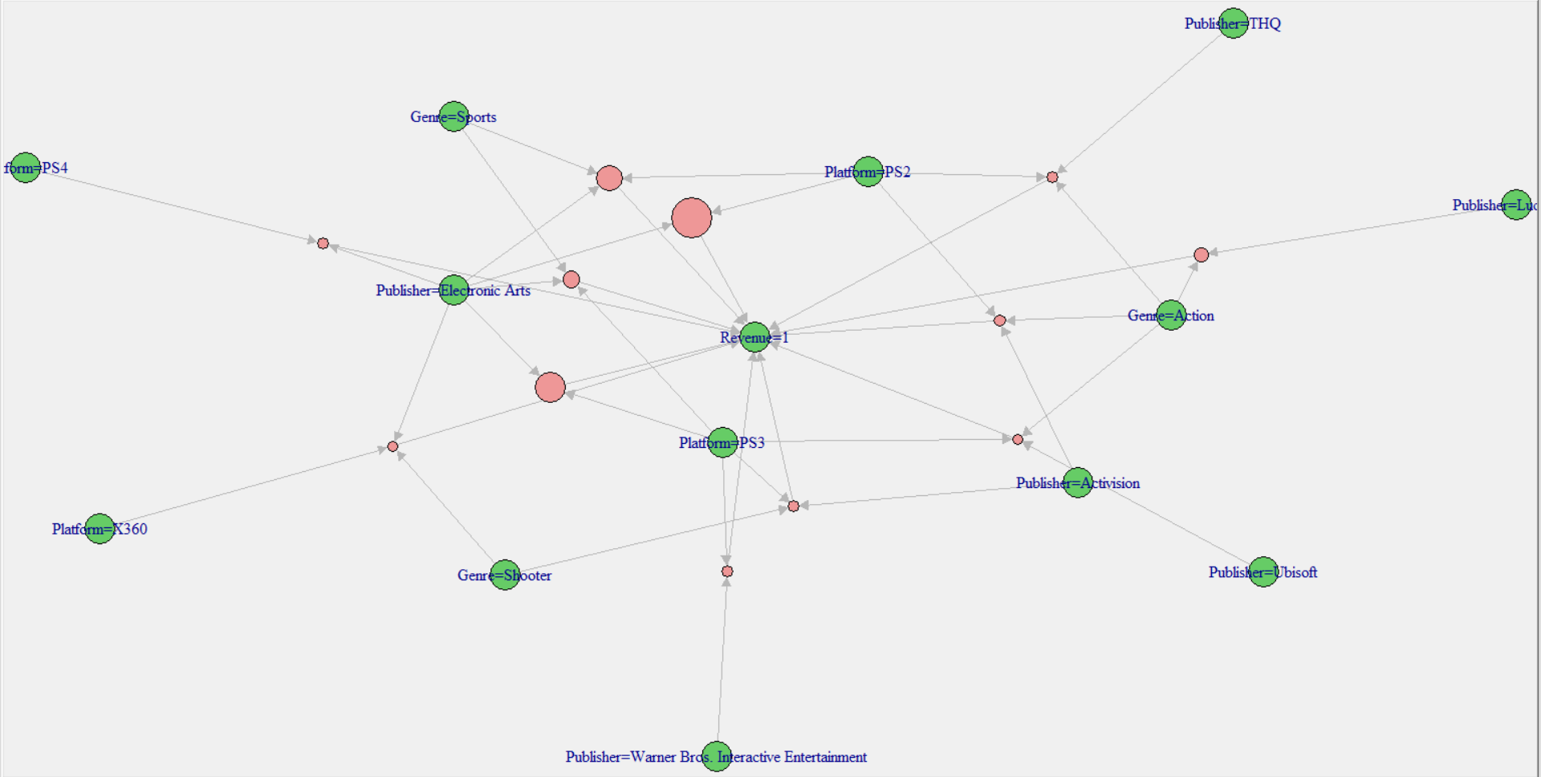
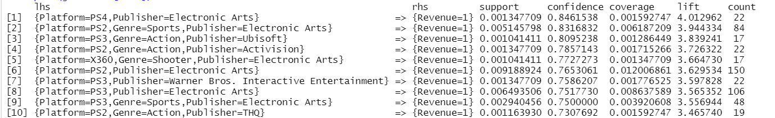
Other Areas

Slide 12
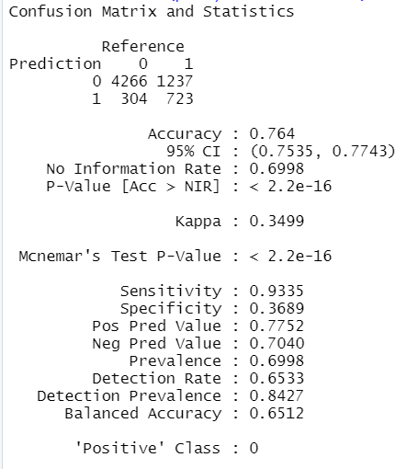
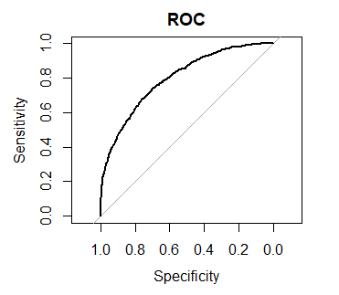
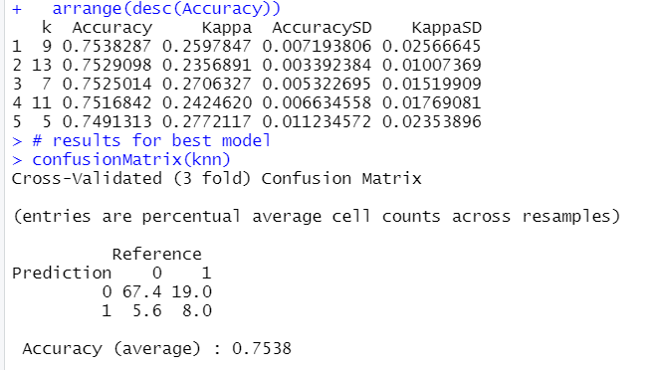
KNN

Slide 13
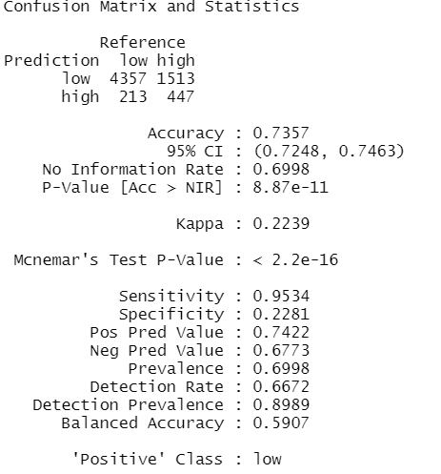
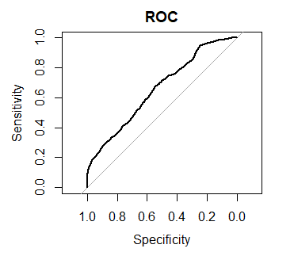
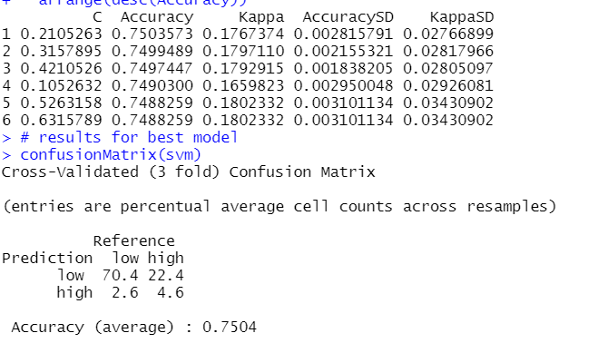
SVM with Linear kernel

Slide 14
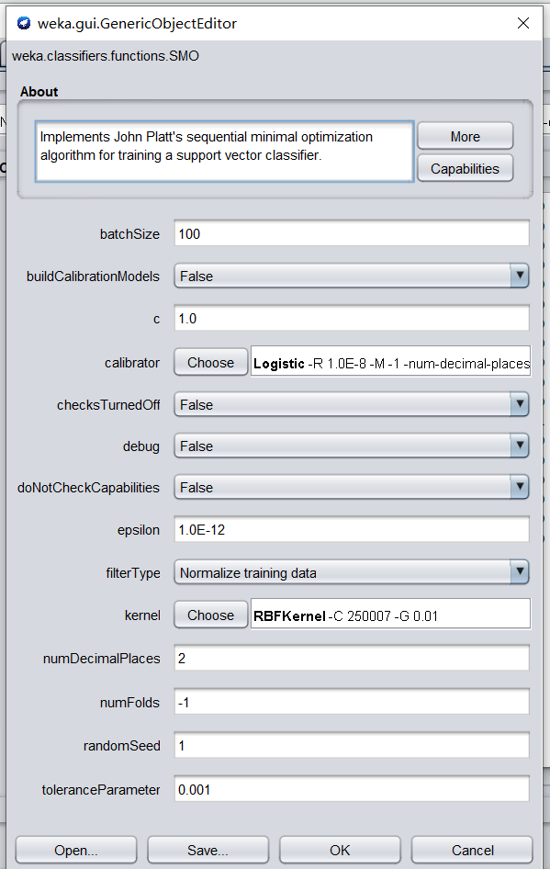
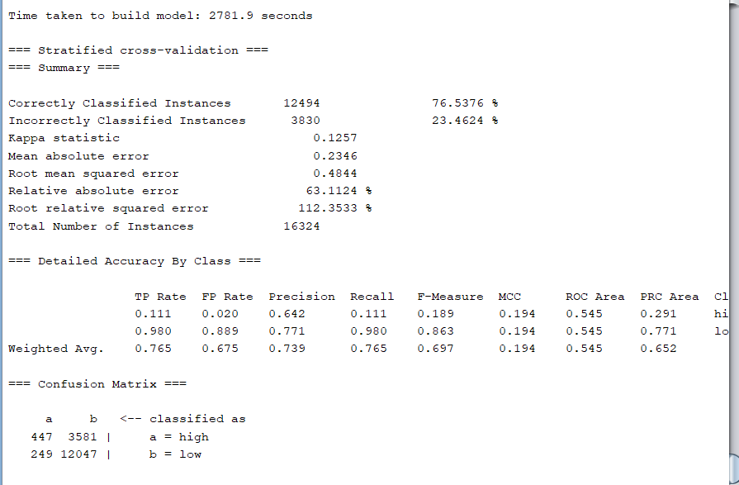
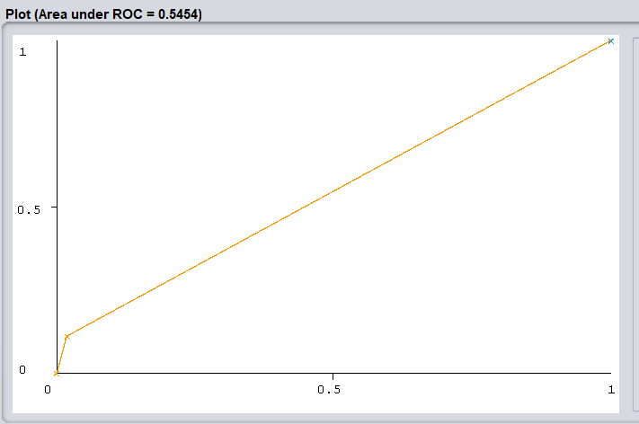
SVM with RBF kernel

Slide 15
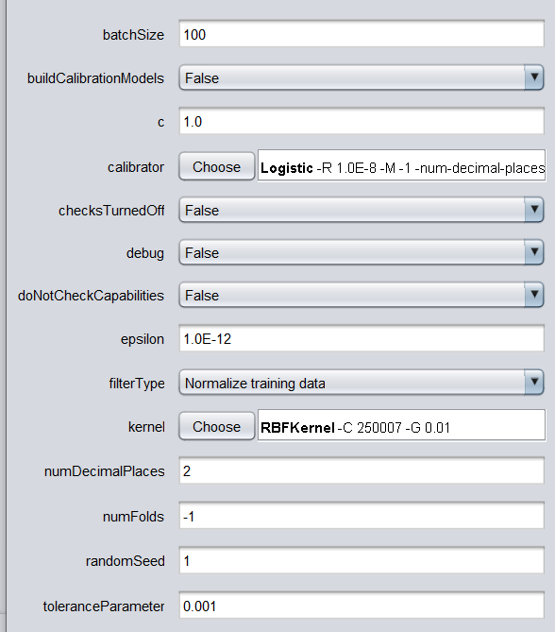
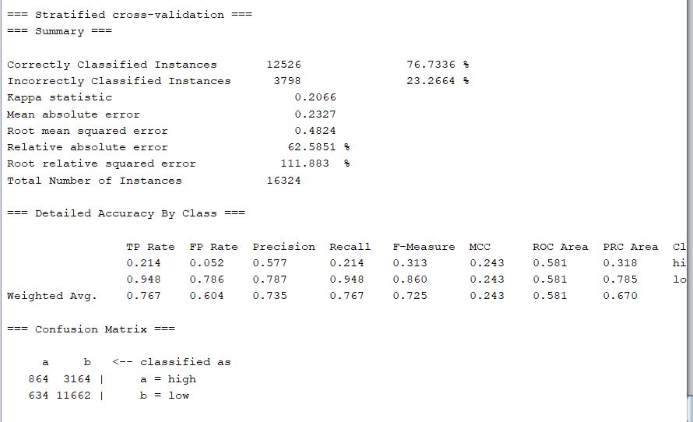
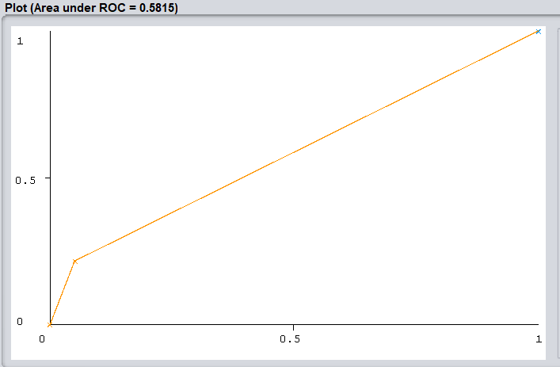
SVM with Polynomial kernel

Slide 16
Conclusion

Slide 17
Final Report
Thanks
May 12, 2021
Syracuse University
iSchool - IST 707
Zeyang Zhou
Reporter:

